Slide 1
Philip Vera Cruz
“If more young people could just get involved in the important issues of Social Justice, they would form a golden foundation for the struggle of all people to improve their lives.”
- Philip Vera Cruz

Slide 2
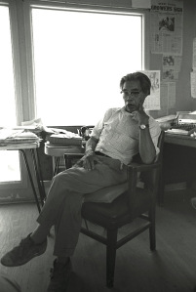
Overview
Filipino American labor leader
Farm worker
Leader of the Asian American Civil Rights movement
Co-founder of Agricultural Workers Organizing committee that later merged with National Farm Workers Association to form the United Farm Workers (UFW)

Slide 3
Life in the Motherland
Philip Vera Cruz was born in Saoag, Illocos Sur on December 25, 1904.
Push Factors
Pull Factors
Devastation left by hundreds of years of Spanish Colonizarion
U.S Control wasn’t much better
Extreme poverty and political turmoil
Promise of a better life.
Jobs and education were more accesible
The American Dream!

Slide 4
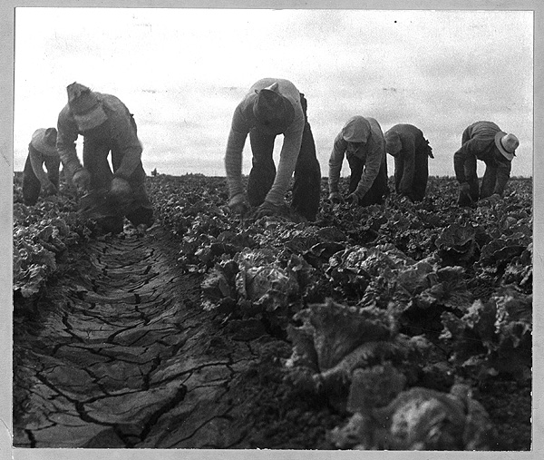
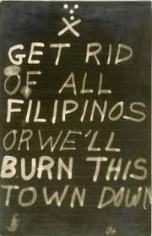
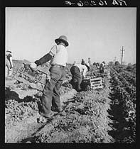
The Reality of the American Dream
Back breaking work for very little pay
Vera Cruz moved to the united stated in 1929.
He worked a multitude of low paying jobs up and down the west coast.
He found that the farm work in California was more difficult than the work he did back in Ilocos.
Filipinos especially farm workers experienced violent racism.

Slide 5
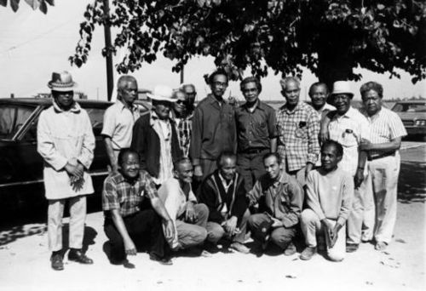
Vera Cruz and the Labor Movement
Vera Cruz settled in California where he became involved with the National Farm Labor Union (NFLU) based in Delano , Ca in 1950.

Slide 6
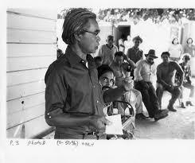
Vera Cruz and the Labor Movement
Vera Cruz’s primary work was in the Agricultural Workers Organizing Committee (AWOC) which comprised of Filipino farm workers.

Slide 7
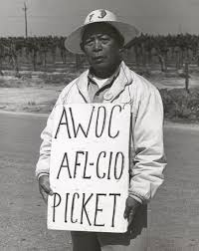
The Delano Grape Strike
On September 8, 1965, the Delano local decided to strike against the grape growers.
Grape growers tried to bring in Mexican laborers as strike breakers.
NFLU members including Philip Vera Cruz and Larry Itliong met with Cesar Chavez and Dolores Huerta of the NFW to discuss a collaboration between the two organizations.

Slide 8
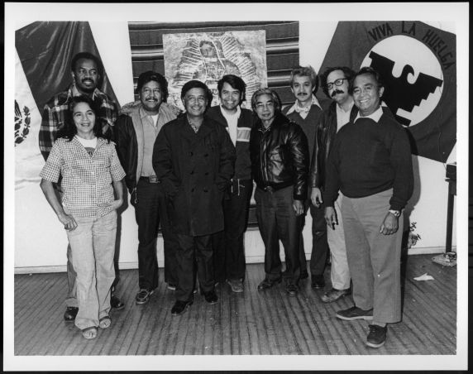
The Delano Grape Strike
The NFW joined the NFLU a week after the strike began.
The two unions became the United Farm Workers (UFW) in 1966 and continued to strike until 1970.

Slide 9
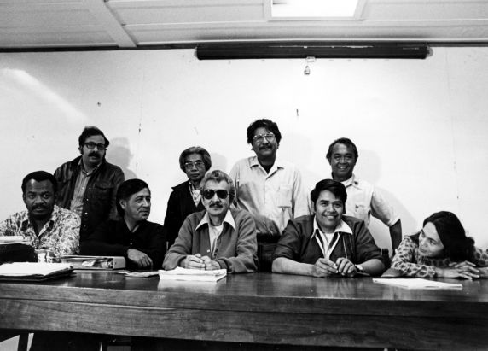
The Delano Grape Strike
Philip Vera Cruz served as second Vice President on the managing board. The highest position held by a Filipino in the UFW.
Vera Cruz left the UFW in 1977 because of political differences with Chavez

